Slide 1
Lift and shift
Notes:
Information in this document, including URL and other Internet Web site references, is subject to change without notice. Unless otherwise noted, the example companies, organizations, products, domain names, e-mail addresses, logos, people, places, and events depicted herein are fictitious, and no association with any real company, organization, product, domain name, e-mail address, logo, person, place or event is intended or should be inferred. Complying with all applicable copyright laws is the responsibility of the user. Without limiting the rights under copyright, no part of this document may be reproduced, stored in or introduced into a retrieval system, or transmitted in any form or by any means (electronic, mechanical, photocopying, recording, or otherwise), or for any purpose, without the express written permission of Microsoft Corporation.
Microsoft may have patents, patent applications, trademarks, copyrights, or other intellectual property rights covering subject matter in this document. Except as expressly provided in any written license agreement from Microsoft, the furnishing of this document does not give you any license to these patents, trademarks, copyrights, or other intellectual property.
The names of manufacturers, products, or URLs are provided for informational purposes only and Microsoft makes no representations and warranties, either expressed, implied, or statutory, regarding these manufacturers or the use of the products with any Microsoft technologies. The inclusion of a manufacturer or product does not imply endorsement of Microsoft of the manufacturer or product. Links may be provided to third party sites. Such sites are not under the control of Microsoft and Microsoft is not responsible for the contents of any linked site or any link contained in a linked site, or any changes or updates to such sites. Microsoft is not responsible for webcasting or any other form of transmission received from any linked site. Microsoft is providing these links to you only as a convenience, and the inclusion of any link does not imply endorsement of Microsoft of the site or the products contained therein.
© 2017 Microsoft Corporation. All rights reserved.
Microsoft and the trademarks listed at https://www.microsoft.com/en-us/legal/intellectualproperty/Trademarks/Usage/General.aspx are trademarks of the Microsoft group of companies. All other trademarks are property of their respective owners.

Slide 2
Abstract and learning objectives
In this whiteboard design session, you will learn how to migrate two existing, but quite different, applications to Azure. You will create both an effective and cost-efficient Azure design, and plan how to achieve migration to that design within the constraints set by the business. You will need to consider a range of different approaches and tools to meet the differing migration needs of each application.
At the end of this whiteboard design session you will be better able to migrate and enable easy deployment for lift-and-shift capabilities. In addition, you will learn to build and deploy complex infrastructure solutions with Azure Resource Manager templates, work with Azure Automation Desired State Configuration (DSC) for deploying server configurations, as well as scale existing templatized deployments leveraging VM Scale Sets.

Slide 3
Step 1: Review the customer case study
Outcome
Analyze your customer needs.
Timeframe
15 minutes

Slide 4
Customer situation
Lucerne Publishing is one of the largest English-language publishers in the world, and with nearly 200 years of history, Lucerne has published some of the world’s foremost authors.
They are consistently at the forefront of innovation with digital technology.
Headquarters is in New York City with publishing groups in the United States, United Kingdom, Canada, Australia, and New Zealand.
Notes:
Lucerne Publishing is one of the largest English- language publishers in the world, and with nearly 200 years of history, Lucerne has published some of the world’s foremost authors
Lucerne is consistently at the forefront of innovation, using digital technology to create unique reading and viewing experiences and expand the reach of its authors and documentary producers
Lucerne is headquartered in New York City and has publishing groups in the United States, United Kingdom, Canada, Australia, and New Zealand

Slide 5
Customer situation
Starting a three-year project to move the majority of its data center footprint to the cloud
Already completed a successful implementation of Office 365 with Azure AD integration
Want to pilot a relatively high-impact workload directly in Microsoft Azure
“We are convinced that cloud implementations will give us cost savings and, more importantly, deliver operational flexibility,” says Greg Vernon, Head of Infrastructure and Enterprise Operations.
Notes:
Lucerne is starting a three-year project to move most of its data center footprint to the cloud. "We are convinced that cloud implementations will give us cost savings and more importantly, deliver operational flexibility," says Greg Vernon, head of infrastructure and enterprise operations at Lucerne. "Like every other business, we are under constant
pressure to do more with less. We believe that cloud computing will be substantially cheaper over time than in-house data centers." Currently, their workloads are hosted in an Equinix collocated data center near
Lucerne's New York office.
Lucerne has already completed a migration to Office 365. One of the key steps that is complete was to use the Microsoft Azure Active Directory (AD) Connect service to synchronize their Windows Server Active Directory Domain users and groups to Azure AD. This enabled Single Sign-On (SSO) to Office 365 and full synchronization of Azure AD and
their Local Active Directory.
With the successful migration to Office 365 behind them, Lucerne now wants to pilot setting up the necessary network infrastructure to connect their environment with Microsoft, and migrating production workloads to Azure.
They have chosen two existing on-premises applications to migrate to Azure for this pilot - a procurement system and an HR application. These have been selected in part for their diverse requirements, to challenge the migration team and build confidence for future migrations.

Slide 6
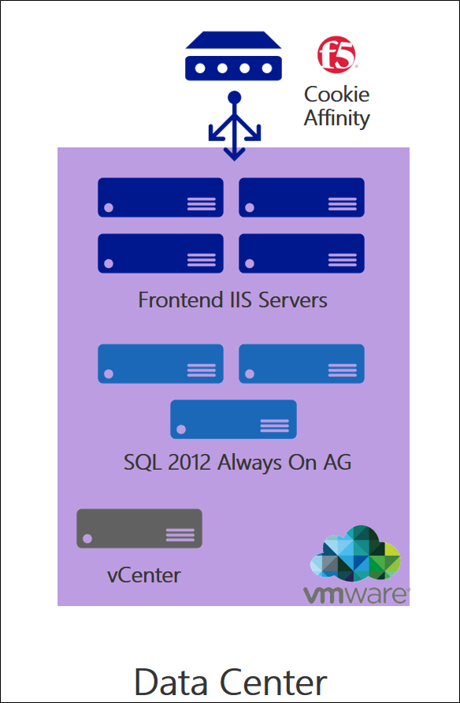
Procurement system
Third-party app deployed on four Windows 2008 R2 Microsoft Internet Information Services (IIS) VMWare VMs that are managed by vCenter
ASP.NET with .NET 3.5
App deployed via a wizard to install assemblies into the global assembly cache (GAC)
IIS hardware: 2 vCPUs Xeon processors and 6 GB of memory on each server
F5 with cookie affinity for session state support
Backend SQL Server 2012 with Always On availability groups
App uses distributed queries, heavy use of TempDB, and SQL Server Reporting Services (SSRS), and has a maximum database size of 600 GB
SQL hardware: 8 vCPUs Xeon processors and 16 GB of memory on each server
Notes:
Jesse Adams is the infrastructure lead responsible for managing the procurement system today. Per Jesse, they use VMware for their virtualization managed using vCenter 6.0. The application is currently deployed on four VMware VMs running Windows Server 2008 R2 with Microsoft Internet Information Services (IIS) and ASP.NET with the .NET Framework 3.5. The application install only supports a wizard-based installation that installs several .NET assemblies that are deployed to the global assembly cache (GAC). Authentication and authorization to the application are based on the user's Windows user account and a specific group in AD the user must belong to. The frontend web servers are load balanced using an F5 load balancer with cookie affinity enabled, because the application uses an in-memory session state. The web servers are currently configured with two vCPUs, six GB of memory, and the Vmware host runs Xeon processors (Skylake). The hardware utilization is unknown at this point in time.
The application itself is accessed by users on Lucerne's corporate network via the URL https://procurement. Jesse is concerned about security to the application and wants to restrict access to only requests from the on-premises network.
The backend for this solution is hosted on a VMware VMs using SQL Server 2012 with Always On availability groups. The solution makes heavy use of TempDB when generating ad hoc reports. The database size for this workload is around 600 GB. The procurement system is a third-party component which is certified for use with all supported versions of SQL Server but not with Azure SQL Database. SQL Server capitalizes on System Center Data Protection Manager (DPM) 2012 R2 for regular backups throughout the day to disk and the backups are then offloaded to tape and eventually to offsite storage.
The database is deployed on VMs, and both are equipped with eight vCPUs and 16 GB of memory running on the same VMware host. The hardware utilization is unknown at this point in time. The hardware is due for a refresh, and as such, this is a prime candidate for migration to Azure. There are currently no plans for a significant change to the underlying application code.

Slide 7
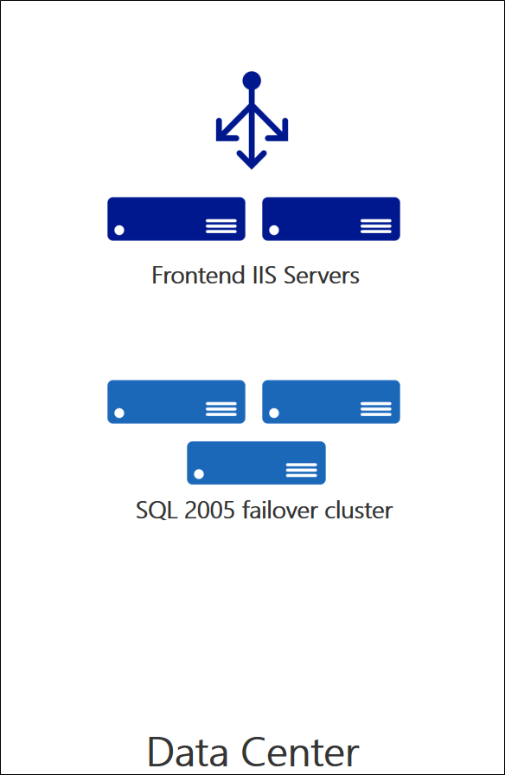
HR application
Bespoke legacy application created in-house by vendors, due for replacement within 24 months
Web tier deployed to two physical servers (two 4-core Xeon CPUs, 4GB memory), single drive, UEFI boot
Windows Server 2012, ASP.NET with .NET 4.5
No application installer available, code in off-site archive, no in-house experience in the code
Database: SQL Server 2005 in failover cluster, using SQL Agent. Tested with SQL Server 2017, licenses already purchased
Database uses similar HW to web servers, but with 16GB memory
Database contains highly sensitive information
Infrastructure team is over-stretched
Feature request for remote user access
Notes:
Ellen Jones is the infrastructure lead responsible for managing the HR application. She has described this as a legacy application, which Lucerne plan to replace within the next 24 months. Ellen's team is stretched and she is keen to minimize any on-going maintenance.
It is a two-tier application architecture, with the web tier running on Windows Server 2012 with Microsoft Internet Information Services (IIS) and ASP.NET with the .NET Framework 4.5. This is implemented on two Dell PowerEdge servers, with two 4-core Intel Xeon CPUs (Sandy Bridge) and 4GB memory. Both the OS and application have been installed on the same drive, which has UEFI boot enabled.
The application is accessed via the internal network via the URL https://AskHR. It is open to all staff, who are identified using their AD credentials. There have been requests to make the application available from outside the corporate network, but due to security concerns this has not yet been implemented.
The database backend runs on SQL Server 2005 in a failover cluster configuration. The database design uses several T-SQL jobs scheduled using SQL Agent. The database size for this workload is relatively small at just under 200 GB. It runs on similar hardware to the web servers, except with 16GB memory and SSD disks. The application has been tested to run with SQL Server 2017, and part of an earlier planned upgrade Lucerne has already acquired licenses for SQL Server 2017 Enterprise Edition with Software Assurance (SA).
The database contains highly sensitive HR information and must be accessible only to the application tier. Lucerne are extremely concerned about this point and are looking for a strong level of assurance that the database will not be accessible via any other means. The application was written in-house using contract staff who are no longer available to the company. No application installers are available. Ellen believes the original source code is in an off-site backup archive, but fears that substantial effort would be required to locate it and rebuild. Even the smallest code change represent a substantial challenge and potential obstacle to migration.

Slide 8
Customer needs
Assess each application for suitability and cost analysis before migrating to Azure
Procurement system: must be available 24/7, including during migration
HR application: 12-hour migration window
High availability and backup/restore required
Perform a full test of the application running in Azure before cutting over
Notes:
Lucerne have asked you to assess each application for suitability and cost analysis before migrating to Azure.
The procurement system is a critical business application. Availability is required 24/7, including during migration.
The HR application is only used in office hours and a once-off 12-hour migration window can be made available.
Each migrated application must offer high availability even if a VM fails or during patching cycles.
Each migrated application must include backup/restore capabilities, for both web and database tiers.

Slide 9
Customer needs
Ability to test before committing
Support "fail back" at any point
Secure and performant connectivity from corporate network
Least-privilege access controls and protect against accidental modification or deletion
Monitor Azure environment for cost and prevent use of unapproved Azure services
Monitor every level of the Azure environment for performance and availability
Notes:
Prior to cutting over production traffic, Lucerne should be able to perform a full test of the application running in Azure to ensure it is fully functional.
Lucerne demands there is a way to "fail back" if something goes wrong at any point in the migration process.
Both applications are Intranet applications. Lucerne requires connectivity from their corporate network to be robust, secure and performant.
All Azure deployments must support least-privilege access controls, and protections to ensure production resources cannot be modified or deleted without authorization or by accident.
Mechanisms must be in place to monitor control and monitor Azure cost and prevent use of unapproved Azure services.
Provide the ability to monitor every level of the Azure environment for performance and availability.

Slide 10
Customer objections
How can we tell how much we will really be spending once we have migrated to Azure?
Moving procurement to the cloud seems like a security problem. It should only be accessible from people at Lucerne’s offices.
We already have licenses for SQL Server. We do not want to pay for them again.
Notes:
The customer’s objections include the following:

Slide 11
Customer objections
Logistics and procurement is one of our most critical applications. Any glitch will cause havoc in our ecosystem. The procurement system migration must be seamless, with no loss of data and no application downtime.
The procurement application is a simple application with known dependencies and is perfect for a pilot. What about more complicated workloads or workloads where we don't exactly know where the dependencies are?
Notes:
The customer’s objections include the following:

Slide 12
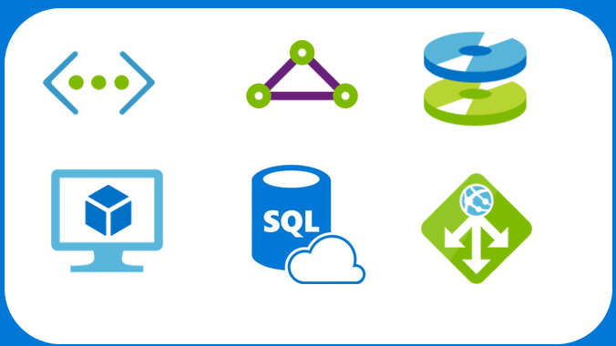

Common scenarios
Azure Infrastructure as a Service (IaaS)
Azure Resource Manager
Virtual machines
Virtual networks
App gateway
SQL Database Managed Instances
ExpressRoute
Load balancers
Managed disks
Role Based Access Control (RBAC)
Azure Policy
Resource locks
Notes:
In the following slides, we will touch on some Azure technologies that can and should be leveraged when thinking about the solution that will be designed for Lucerne Publishing. In the corresponding Case Study document, you will also find links that elaborate even further on these topics.
In this slide we call out Azure infrastructure as a service (or IaaS) components – Virtual Machines & Virtual Networking (highlighting a couple of ways to connect to the Azure cloud – by way of a Site to Site Connection or a Point to Site connection)
Azure Resource Manager is the API surface layer for managing resources in Azure. It provides two features that may come in useful:
Role Based Access Control – allows you to define who can perform what action
Resource Manager Policies – allows you to define what actions can be performed on an Azure Subscription
Locks – allows you to define policies to block accidental deletion of resources

Slide 13
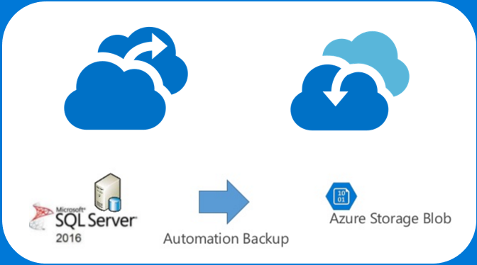
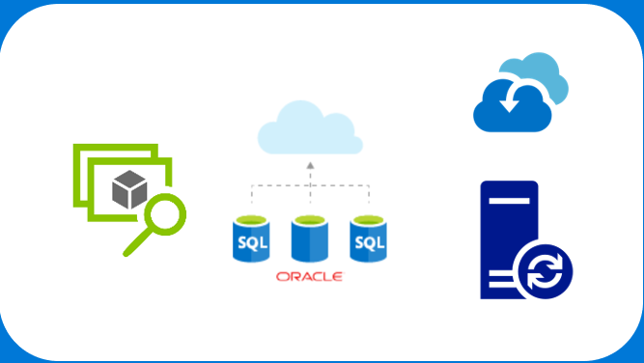
Common scenarios
Backup and business continuity
Migration tools
Azure Backup
Azure Migrate
Database Migration Service
Azure Site Recovery
SQL Server Managed Backup
Database Migration Assistant
Azure Site Recovery
Third-party tools
Notes:
Some of the solutions you may consider could involve:
Azure Site Recovery – this service provides the ability to replicate virtual machines or physical servers to Microsoft Azure.
Azure Backup – this service provides several abilities including the ability to backup a VM directly, files or folders, or workload specific backup such as SQL Server, AD, HyperV and VMWare.
SQL Server Managed Backup – this feature in SQL Server allows you to use Azure Storage as a backup target
Azure Migrate – service that provides many features that may come in useful during a lift and shift migration
Azure Database Migration Service – service currently in preview that helps migrate databases to the cloud
Azure Database Migration Assistant – downloadable application that can help migrate databases to the cloud

Slide 14
Step 2: Design the solution
Outcome
Design a solution and prepare to present the solution to the target customer audience in a 15-minute chalk-talk format.
Timeframe
60 minutes
Business needs (10 minutes) | Respond to questions outlined in your guide and list the answers on a flipchart.
Design (35 minutes) | Design a solution for as many of the stated requirements as time allows. Show the solution on a flipchart.
Prepare (15 minutes) | Identify any customer needs that are not addressed with the proposed solution. Identify the benefits of your solution. Determine how you will respond to the customer’s objections. Prepare for a 15-minute presentation to the customer.

Slide 15
Step 3: Present the solution
Outcome
Prepare to present a solution to the target customer in a 15-minute chalk-talk format.
Timeframe
30 minutes (15 minutes for each team to present and receive feedback)
Directions
Pair with another table.
One table is the Microsoft team and the other table is the customer.
The Microsoft team presents their proposed solution to the customer.
The customer asks one of the objections from the list of objections in the case study.
The Microsoft team responds to the objection.
The customer team gives feedback to the Microsoft team.

Slide 16
Wrap-up
Outcome
Identify the preferred solution for the case study.
Identify solutions designed by other teams.
Timeframe
15 minutes

Slide 17
Preferred target audience
Greg Vernon, Head of Infrastructure and Operations
Jesse Adams, Procurement system Infrastructure Lead
Ellen Jones, HR Application Infrastructure Lead
Identity and security Leads
Network engineering
Procurement infrastructure team

Slide 18
Networking (1/2)
ExpressRoute using private and Microsoft peering
A simple Virtual Network design given the address space of 10.0.1.0/24 could have the following subnets:
10.0.1.0/28: ExpressRoute (requires /28 or greater)
10.0.1.16/28: Application Gateway (requires dedicated subnet)
10.0.1.64/28: Procurement web tier
10.0.1.80/28: Procurement DB tier
10.0.1.128/28: HR App web tier
10.0.1.144/28: HR App DB tier
Notes:
Note that ExpressRoute Gateways and Application Gateways each require dedicated subnets.
ExpressRoute requires a /28 subnet or larger
Application Gateway requires one private IP address per instance, plus the front-end private IP address. Azure reserves the first 4 IP addresses in each subnet for internal use A /28 subnet is therefore recommended to allow headroom for additional gateway instances in future.

Slide 19
Networking (2/2)
No public IP address, so no internet access
Use network security groups to control traffic between tiers and allow traffic from the on-premises network
Configure the Virtual Network to reference the on-premises Active Directory for the pilot
Option: break network into separate virtual networks, connected using peering
Enables separate access control on different IP ranges
Notes:
A network security group should be created to allow inbound and outbound traffic from the on-premises 172.16.0.0/16 network and between the Procurement and Database subnets in Azure to minimize the attack surface.
Configure the Virtual Network to reference the existing AD Domain Name System (DNS) Infrastructure to enable users to successfully authenticate. Deploying domain controllers in the same virtual network would be advised once the deployment moves out of the pilot phase.
Optionally, the network space could be broken down into three separate virtual networks for the shared infrastructure components, and application specific components. These networks would then be connected using Virtual Network Peering. This approach has the advantage of allowing delegated permissions to be assigned independently for each virtual network. With a single virtual network, the network administrator will have full control over all subnets.

Slide 20
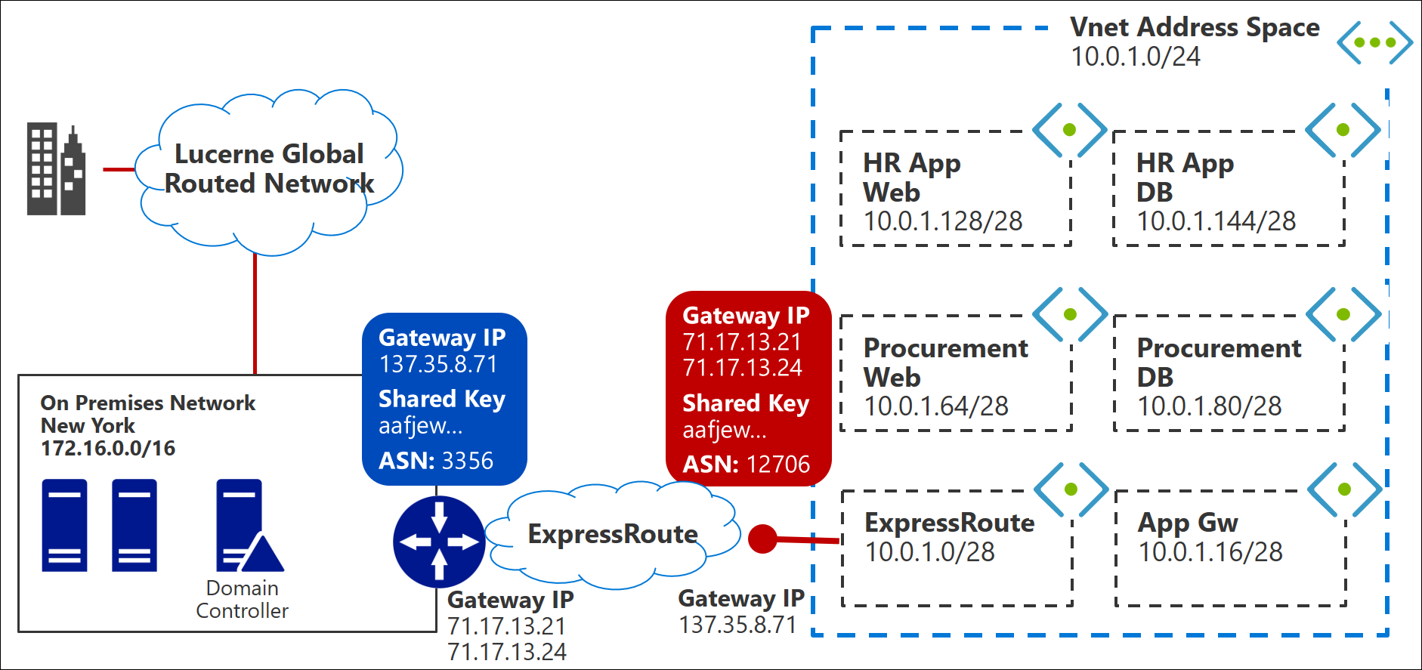
Lucerne network design

Slide 21
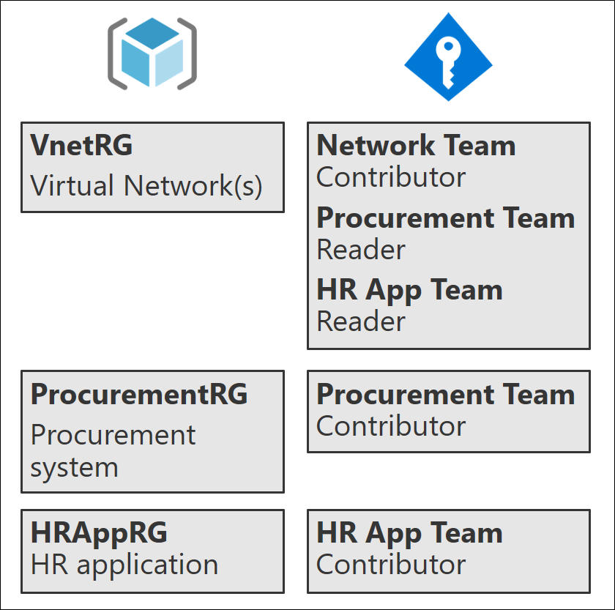
Design for limiting access to resources
Lucerne should use the same Azure AD tenant that they use for Office 365
Separate resource groups enable separate management using role-based access control
Virtual network resource group
Procurement system resource group
HR application resource group
Notes:
When creating the Azure Subscription, it is critical that the default directory point to the existing Office 365 AD Tenant
(This will require Global Admin rights on the Office 365 Tenant). This enables existing Azure AD user identities and groups to be used to control access to Azure resources.
When deploying resources, Lucerne should use separate resource groups for the virtual network, the procurement system, and the HR application. This will allow Lucerne to segment out resources and assign management rights just to the team that requires them.

Slide 22
How to monitor and control spend?
Use Azure Policy to control:
Locations resources can be created
Required tags
Image types that can be created
Instance sizes for VMs
Services that can be used (service catalog)
Use Azure Cost Management for detailed reports of current and forecast spend.
Use Resource Manager tags to assign spending to specific teams or cost centers.
Notes:
Using Azure Resource Manager policies Lucerne can set the following constraints:
- Locations resources can be created
- Image types that can be created
- Instance sizes for VMs
- Services and service tiers that can be used (a 'service catalog')
Lucerne can use Azure Cost Management to create detailed reports of current and forecast spend.
Resource Manager tags can be used to assign spending to specific teams or cost centers

Slide 23
How to monitor performance and availability?
Use Azure Monitor to collect:
Near real-time metrics from various Azure services
Application monitoring data
Azure resource monitoring data
Azure subscription monitoring data
Azure tenant monitoring data
Interactively query and analyze monitoring data
Proactively alert for critical conditions
Take automated action or integrate with other systems with Event Hubs and Logic Apps

Slide 24
Procurement - Azure migrate
Assess Azure readiness: Assess whether your on-premises machines are suitable for running in Azure.
Get size recommendations: Get size recommendations for Azure VMs based on the performance history of on-premises VMs, plus configurable 'comfort factor’.
Estimate monthly costs: Get estimated costs for running on-premises machines in Azure, including Hybrid Benefit.
Migrate with high confidence: Visualize dependencies of on-premises machines to create groups of machines that you will assess and migrate together. You can accurately view dependencies for a specific machine, or for all machines in a group.
Notes:
The Azure Migrate Service can be used to assess the infrastructure in your environment. The Azure Migrate service
assesses on-premises workloads for migration to Azure. The service assesses migration suitability and performance-based sizing, and provides cost estimations for running your on-premises machines in Azure.
The Azure Migration Service provides the following benefits:
Assess Azure readiness: Assess whether your on-premises machines are suitable for running in Azure.
Get size recommendations: Get size recommendations for Azure VMs based on the performance history of on-premises VMs. You can specify a 'comfort factor', which is a buffer applied on top of the measured utilization when making sizing recommendations.
Estimate monthly costs: Get estimated costs for running on-premises machines in Azure. You can specify the VM pricing tier (basic/standard). The estimate will also account for Azure Hybrid Benefit (to re-use existing licenses) and any Azure offers you are enrolled to
Migrate with high confidence: Visualize dependencies of on-premises machines to create groups of machines that you
will assess and migrate together. You can accurately view dependencies for a specific machine, or for all machines in
a group.

Slide 25
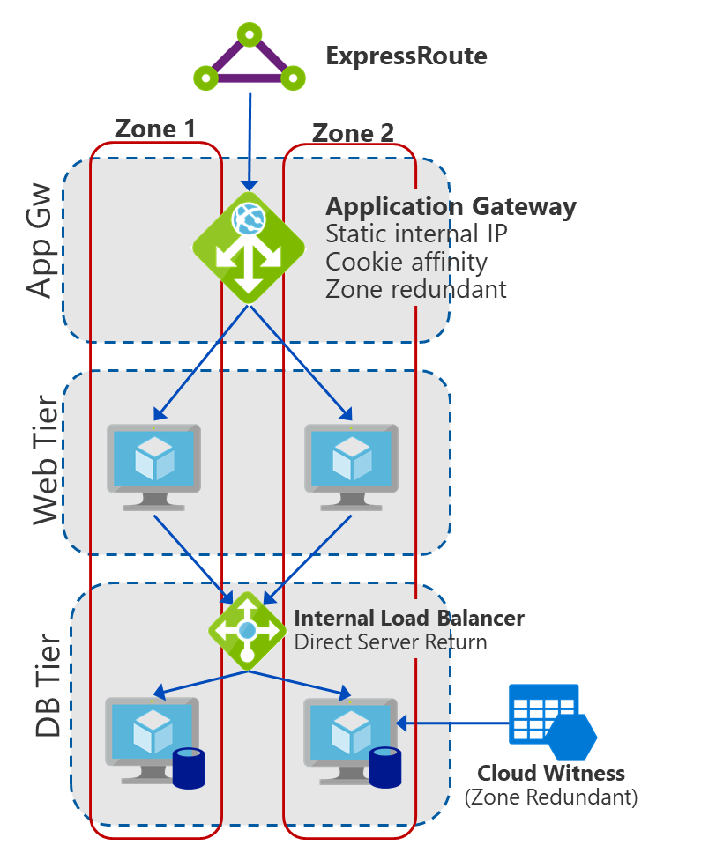
Procurement - preferred solution
Web tier: DS2_v2 or D2S_v3 VMs hosted across availability zones
Database tier: DS3_v2 or D4S_v3 VMs hosted across availability zones, running SQL Server with bring your own licenses (BYOL), Always On and Cloud Witness
Hybrid connectivity with ExpressRoute
Azure Application Gateway for load balancing and cookie affinity
Notes:
Web tier using Azure Virtual Machines: The application install has a dependency on the global assembly cache, which rules out Azure Web Apps. These machines should be configured as DS2_v2 or D2S_v3. This will provide for the required cores and RAM to meet the needs of the machines. A data disk could be added to the VMs depending upon the needs of the application or if it doesn't meet the requirement of Read/Write Cache which is on by the default with all Azure VMs.
Database tier using Azure Virtual Machines and SQL Server 2012, due to the unknown compatibility of the third-party procurement system and Azure SQL Database. The customer should likely reach out to the third-party vendor to
determine the roadmap on when and if Azure SQL Database will be officially supported.
Migration is a good opportunity to upgrade from the existing SQL Server 2012 to SQL Server 2017, rather than leaving
behind a future upgrade task. However this will also require them to upgrade their existing SQL licenses. Using SQL 2012 allows existing licenses to be re-used under the Azure Hybrid Benefit.
The most likely instance size in Azure to match the existing hardware would be the DS3_v2 or D4S_v3 instance. The
Both support four cores, 14 or 16 GB per server, and supports Premium storage for high-performance Solid-State Disk
(SSD)-backed disks. Premium Storage will be used for both the web and database VMs. To ensure the best performance, use a disk layout on the VM that consists of: Logs should be on a separate disk (non-cached), Data on another disk (Cached disk). Also, never use the drive letter E: as some Hosts in Azure have DVD drives which will cause issues starting if drive letters change upon booting.
Application Gateway: To provide access to the procurement application and ensure that the needs are met for the requirement of cookie session affinity, an Azure Application Gateway will be built. As an alternative, administrators could also utilize an F5 from the Azure Marketplace.

Slide 26
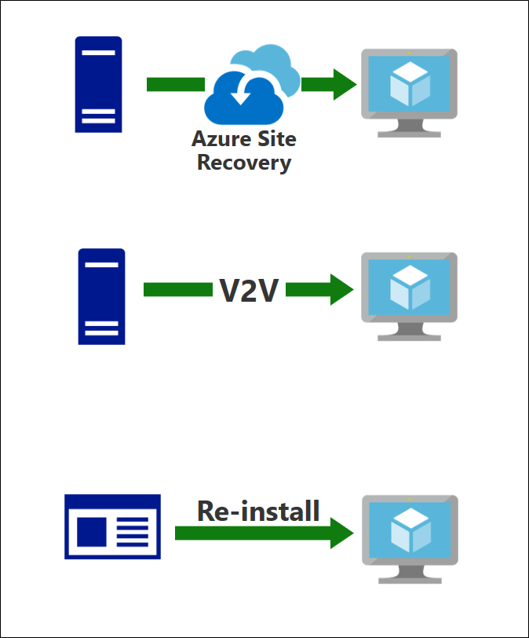
Procurement – web tier migration options
Option 1: Migrate the IIS servers to Azure using Azure Site Recovery (ASR).
Option 2: Convert VMware VMs to Azure VMs using the Starwind V2V Converter and upload as specialized images.
Option 3: Create infrastructure manually and manually re-install.
Enables upgrade to Windows Server 2017

Slide 27
Procurement – web tier migration steps
Create the Azure Application Gateway with a static internal IP.
Migrate servers using one of the 3 methods presented.
Configure the App GW backend server pool to reference the newly migrated web servers.
Set cookie-based affinity on the backend HTTP server settings list.
Update http://procurement DNS entry to point to App Gw static internal IP.
Notes:
Over the next 11 slides we will talk through the migration steps that Lucerne Publishing should follow for a successful migration.

Slide 28
Procurement – database tier migration steps
Deploy new Azure VMs with SQL Server across two or more Availability Zones.
Configure internal load-balancer with Direct Server Return (DSR).
Extend existing Always On availability group to new Azure VMs.
Pause web tier or place in read-only mode.
Fail over SQL primary to Azure VM.
Update web tier to use ILB as database endpoint.
Re-start web tier.
Notes:
SQL Server VMs should be deployed across at least two Availability Zones. A cloud witness should be deployed to support the Windows Failover Cluster, this will allow the cluster to handle a datacenter level outage

Slide 29
HR App – migration assessment
The Azure Migrate tool does not currently support assessment of physical infrastructure.
Third-party alternatives should be considered (see list at https://azure.microsoft.com/migration/assess/).
Use the Microsoft Assessment and Planning Toolkit https://www.microsoft.com/en-us/download/details.aspx?id=7826
Notes:
The Azure Migrate Service can be used to assess the infrastructure in your environment. The Azure Migrate service
assesses on-premises workloads for migration to Azure. The service assesses migration suitability and performance-based sizing, and provides cost estimations for running your on-premises machines in Azure.
The Azure Migration Service provides the following benefits:
Assess Azure readiness: Assess whether your on-premises machines are suitable for running in Azure.
Get size recommendations: Get size recommendations for Azure VMs based on the performance history of on-premises VMs. You can specify a 'comfort factor', which is a buffer applied on top of the measured utilization when making sizing recommendations.
Estimate monthly costs: Get estimated costs for running on-premises machines in Azure. You can specify the VM pricing tier (basic/standard). The estimate will also account for Azure Hybrid Benefit (to re-use existing licenses) and any Azure offers you are enrolled to
Migrate with high confidence: Visualize dependencies of on-premises machines to create groups of machines that you
will assess and migrate together. You can accurately view dependencies for a specific machine, or for all machines in
a group.

Slide 30
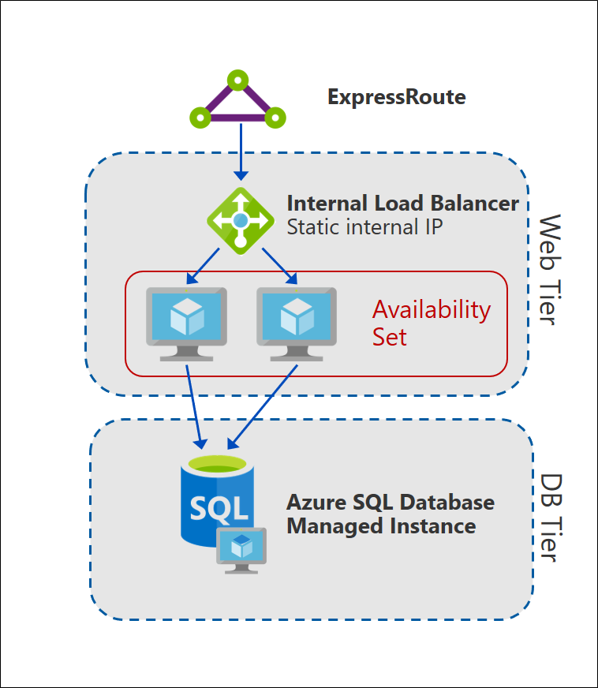
HR App - preferred solution
Web tier: Migrate to Azure VMs, with Azure Load Balancer
Database tier: Migrate to Azure SQL Database Managed Instances
Managed Instances are required for SQL Agent (not supported on vanilla Azure SQL Database).
Managed Instances enable deployment to Virtual network, giving network access control via NSG.
Managed Instances are a fully-managed service, reducing maintenance tasks.
Notes:
Due to the lack of application installers, and the need to migrate quickly, the web tier should be migrated to Azure VMs.
Using Azure App Service is unsuitable since it will require access to the application code and require more time. In addition, since this is an internal application, using Azure App Service will require an App Service Environment, which will add significant additional cost.
Based on the desire for minimal on-going maintenance, Azure SQL Database Managed Instances should be considered in preference to running SQL Server in Azure VMs. (Using SQL Server in VMs is a good 'plan B' in case an unexpected compatibility issue arises.)
Note that the vanilla Azure SQL Database service is unsuitable due to the requirement for T-SQL jobs scheduled using SQL Agent; however this **is** supported on Azure SQL Database Managed Instances.

Slide 31
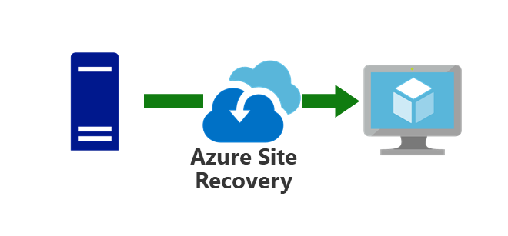
HR App – web tier migration steps
Use Azure Site Recovery to migrate physical servers to Azure VMs.
Configure Azure environment including Recovery Services Vault, Virtual Network and Storage Account
Setup ASR on-premises including ASR Configuration Server
Replicate web-tier servers to Azure Storage
Test and Initiate planned failover to Azure VMs
Reconfigure Internal Load Balancer backend pool to point to web server VMs in Azure
Update DNS entry for 'http://AskHR'
Notes:
Azure Site Recovery could be used to migrate the web tier. The application installers are not available, and so re-installing the application
onto clean Azure VMs would be very difficult. The steps to migrate would be similar to migrating the procurement application.
Use ASR to facilitate the migration. ASR supports physical servers to ARM failovers and can be used for the web tier of the application. This allows for simple migration of the application without the need for the original application installers.
Use the [Azure documentation](https://docs.microsoft.com/en-us/azure/site-recovery/physical-azure-architecture) to set up ASR replication. This includes:
- Provisioning the Azure environment (Recovery Services Vault, Virtual Network and Storage Account).
- Setting up ASR in the on-premises environment, including deploying the ASR Configuration Server
and connecting it with your Recovery Service Vault.
- Replicating the web tier servers to Azure Storage. This includes setting the replication policy
which defines the retention period (0 suffices since we will only use the latest recovery point),
the type of snapshots to use (crash-consistent snapshots suffices for the web tier), and whether
to use a replication group.
To test the migration before the live site cutover:
- Initiate a test failover from the Azure portal. This will create
new Azure VMs from the replicated data from the legacy web servers.
These VMs will be connected to the on-premises production database
(if desired, a test database could be configured).
- Configure the backend server pool of the Internal Load Balancer
to reference the HR web servers.
- Test the new web tier via the Internal Load Balancer front-end IP.
To perform the migration:
- Initiate a planned failover from the Azure portal. As with the test
failover, this will create Azure VMs from the replicated web tier disks,
connected to the on-premises production database.
- Update the Internal Load Balancer back-end server pool to reference
the new web server VMs, and validate the application is working.
- Update the DNS entry for the 'https://<span></span>AskHR' endpoint
to point to the Internal Load Balancer front-end.
Rollback (if required):
- If the migration does not work properly, there is a simple back out plan. The
planned failover should be canceled from the portal and
then the physical servers on-premises should be restarted to restore
service.
- If the 'AskHR' DNS entry has already been updated, revert it to the previous value.
> **Note**: To minimize the impact of DNS caching, the Time-To-Live (TTL) for the DNS entry
should be reduced to a short value (e.g. 60 seconds) well in advance of the migration.
This enables DNS changes during migration and roll-back to take effect quickly.
Once migration is successful and stable, the TTL should be returned to a long value (e.g. 1 day)

Slide 32
HR App – database tier migration steps
Migrate using Azure Database Migration Service
Complete pre-requisites, e.g. setting up the Virtual Network, accounts, etc.
Create an Azure Database Migration Service resource and migration project.
Specify the settings for the Azure SQL Database Managed Instance.
Run the migration, specifying the storage location for backup files.
View the migration report.
Validate the migrated database.
Update the web tier to use the new database.
Notes:
Migrating the database to Azure SQL Database Managed Instances can be executed using the Azure Database Migration Service (https://docs.microsoft.com/azure/dms/dms-overview). This is a fully managed service designed to enable seamless migrations from multiple database sources to Azure Data platforms with minimal downtime.
Support for Azure SQL Database Managed Instances is currently in Preview. Microsoft publishes detailed step-by-step guidance on how to
execute the migration (https://docs.microsoft.com/azure/dms/tutorial-sql-server-to-managed-instance).
To summarize the migration steps:
Complete pre-requisites, such as setting up the Virtual Network ensuring the correct network connectivity, setting up logins, etc.
Create an Azure Database Migration Service resource, specifying the destination Virtual Network.
Create a Migration Project, and specify the source database.
Specify the setting for the Azure SQL Database Managed Instance, which the migration process will provision for you.
Run the migration, specifying the storage location for backup files and login details.
View the migration report, validate the migrated database, and update the web tier to use the new database.
If issues arise during migration, Microsoft have also published detailed documentation on how to execute a manual migration (https://docs.microsoft.com/azure/sql-database/sql-database-managed-instance-migrate).

Slide 33
Additional benefits
Azure SQL Database Managed Instances include built-in high availability—an improvement over the existing database failover solution.
Optionally, Lucerne could deploy Azure AD Application Proxy to enable remote access to the HR application without exposing Internet-facing port.
Notes:
By migrating the database to Azure SQL Database Managed Instances, the service will benefit from improved from the high availability features which are built-in to this service (similar to SQL Always On availability groups). This is an improvement over the previous database failover cluster implementation.
It may be possible to deploy Azure AD Application Proxy to make the application available to remote users, without having to open the application to traffic from the Internet.

Slide 34
Availability and Backup
Availability
Web and Database tiers are deployed to availability sets or availability zones as appropriate.
Web tiers use load balancers (App Gw or Azure LB) with health probes.
Databases use SQL Always On Availability Groups.
Availability monitoring and alerting through Azure Monitor.
Backup: 3 options
Microsoft Azure Backup Server
SQL Server Managed Backup to Microsoft Azure
Native support for SQL Server on VMs in Azure Backup
Low cost, zero infrastructure, fully-managed service
Currently in Preview
Notes:
Both applications will be configured with availability sets on both web and database tiers to minimize host outages from hardware and host updates.
The web tier will have load balancing enabled to accommodate for individual VM failures. The database will use a SQL Always On availability
group similar behavior of their existing procurement system deployment, and a significant upgrade for the HR Application.
There are 3 Backup options:
Use Azure Backup Server. The downside is that this requires additional infrastructure (the backup server) to be deployed, maintained, and paid for.
Use built-in SQL backup. For SQL Server 2017, this can back up directly to an Azure Storage account. It does not offer centralized management or long-term retention.
Use the Azure Backup Service. A new feature of Azure Backup (in Preview at the time of writing) is native support to back up SQL databases running in Azure VMs. This is a low-cost, fully-managed zero-infrastructure service that allows you to centrally manage your backups across all your databases.
It's important to note that Azure Backup Server and Azure Backup Service both use a Recovery Services Vault which by default is Geo-Replicated, so here are always three copies of the data in two regions (each region has 3 copies). If a DBA uses SQL Server backup directly to Azure Storage, the Storage Account that is used should have GRS enabled to ensure there are copies of the SQL Server BAK files in two locations.

Slide 35
Preferred objection handling
Objection
How can we tell how much we will really be spending once we have migrated to Azure?
Potential answer
Using the Azure Migrate service, Lucerne Publishing could monitor their existing on-premises solutions prior to migration and review the suggested virtual machine sizes and estimated cost for running the solution in Azure.

Slide 36
Preferred objection handling
Objection
The procurement application should only be accessible for people at Lucerne’s offices. Putting it in the cloud seems like a security problem.
Potential answer
Lucerne deployed Azure ExpressRoute. With ExpressRoute the connection between the on-premises network and the Azure virtual network is dedicated and private and does not traverse the public Internet at all.
Network security groups can also be used to further limit network communication. For instance, a network security group could be used to only allow the on-premises network and restrict other address spaces in the virtual network itself.

Slide 37
Preferred objection handling
Objection
We already have licenses for SQL Server. We do not want to pay for them again.
Potential answer
For the procurement system, the existing SQL licenses can be re-used. Either deploy Windows Server VMs and install SQL Server, or use a 'BYOL' SQL Server VM from the Azure Marketplace.
For the HR system, the existing SQL Server 2017 licenses can be used for the Azure SQL Database Managed Instance deployment.

Slide 38
Preferred objection handling
Objection
Our operations team is new to the cloud and currently uses existing technologies like SCOM. We are concerned about the time it takes to learn new technologies to monitor and maintain an existing workload.
Potential answer
Virtual machines in Azure are not that different from virtual machines in Hyper-V. With hybrid connectivity, SCOM could be used to manage the cloud-based deployment in the same way as they are today.

Slide 39
Preferred objection handling
Objection
Procurement is one of our most critical applications. Any glitch will cause havoc in our ecosystem. The procurement system migration must be seamless, with no loss of data and no application downtime.
Potential answer
Both on-premises and Azure-based web servers are deployed in parallel, with the cut-over occurring at the DNS level. This is seamless for users.
For the database, a short migration window (in the order of minutes) is required when failing over the primary replica. Failing over the database without pausing or using a read-only mode on the web app is possible, if the transaction volume is low.
Notes:
For the web tier, both on-premises and Azure-based web servers are deployed in parallel, with the cut-over occurring at the DNS level by updating the http://procurement endpoint DNS entry. This should be seamless for the end users. Even existing sessions will not be interrupted, since they will continue on their existing server until they are terminated. The only possible effect is loss of cookie affinity as new sessions are established against the new servers.
For the database, a short migration window (in the order of minutes) is required when failing over the primary replica. The impact can be minimized by switching the web tier to a read-only mode, if one is available. Failing over the database without pausing or using a read-only mode on the web app is possible, if the transaction volume is low. Switch the availability group to synchronous mode to failover with no chance of data loss. Synchronous mode will have a performance impact on the application so this is best done during off-peak hours.

Slide 40
Preferred objection handling
Objection
The procurement application is a simple application with known dependencies and is perfect for a pilot. What about more complicated workloads or workloads where we do not exactly know where the dependencies are?
Potential answer
Using dependency visualization from Azure Migrate, you can view the network dependencies of specific machines, or across a group of machines. This is useful in ensuring no functionality is lost (or machines forgotten) in the migration process when apps and workloads run across multiple machines.

Slide 41
Customer quote
“By using Azure, we can focus on our primary business, which is publishing, rather than on building and managing data centers, which can often be complicated, time-consuming, and expensive.”
—Greg Vernon, Head of Infrastructure and Enterprise Operations,
Lucerne Publishing
Notes:
The following quote by Greg Vernon, Head of Infrastructure and Enterprise Operations, at Lucerne Publishing summarizes the benefits of moving to the Azure cloud.
Thank you for your participation in this real-world case study.

